Slide 1
Cookbook for Practice 4.2
实践4.2攻略
Cong Li 李聪

Slide 2
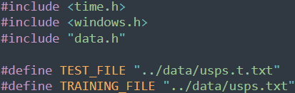

Basic Settings 基本设置
Create a new file ‘dp.cpp’
创建一个新文件’dp.cpp’
Similar to earlier work, include the header files & define the training & test data files
和以前的做法类似，应用头文件并定义训练和测试数据文件
Define an optional compiler macro for thread number
定义一个可选的编译设置作为线程数

Slide 3
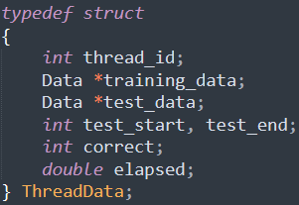
Thread Data 线程数据
Each thread independently processes part of the test data
每个线程独立处理一部分测试数据
Define a struct for transferring critical data to a thread
为将关键数据传给线程定义一个结构
Training & test data, start & end of the test data to be processed by the thread, number of correct samples classified, & elapsed time of the thread
训练和测试数据，该线程处理的测试数据的开始和结束，正确分类的数据个数，该线程耗时

Slide 4
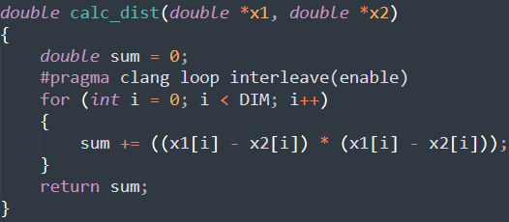
Distance Calculation 距离计算
Use the same function for Euclidean distance calculation
使用同样的计算欧氏距离的函数

Slide 5
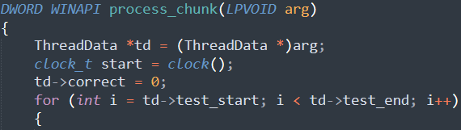
Thread Processing 线程处理 (1)
Write the thread function, looping over part of the test data to be processed by the thread
编写线程函数，只循环遍历该线程处理的部分测试数据

Slide 6
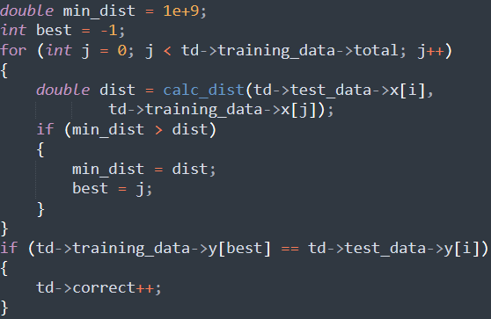
Thread Processing 线程处理 (2)
Inside the loop, perform nearest neighbor classification & check correctness
在循环内，进行最近邻分类并检查正确性

Slide 7

Thread Processing 线程处理 (3)
Close the outer loop & finalize thread function
结束外重循环和线程函数

Slide 8


Main Program 主程序
Similar to earlier work, start the ‘main’ function by reading training & test data files
和以前的做法类似，在’main’函数开始时读取训练和测试数据
Then create thread handles & thread data
在主程序中创建线程句柄和线程数据

Slide 9
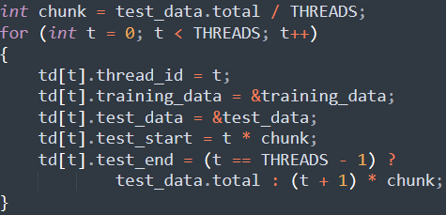
Thread Data Initialization
线程数据初始化
Initialize the thread data, specifically calculate the start & end of the test data to be processed by each thread
初始化线程数据，尤其是计算每个线程
处理的测试数据的起始和结束位置

Slide 10
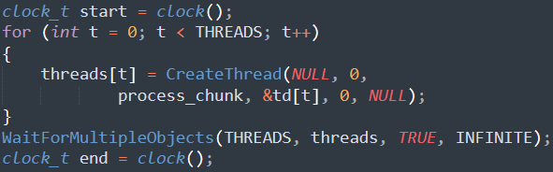
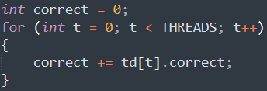
Run the Threads 运行线程
Start timing, run the threads, wait for them, & stop timing
开始计时，运行各线程，等待他们结束，停止计时
Aggregate the number of correct recognition
汇总正确识别的结果

Slide 11
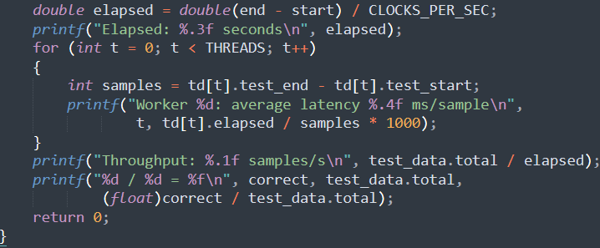
Result Output 结果输出
Final output 最终输出
Compile & run it 编译并运行之
mingw32-make SRC=dp.cpp EXTRA_CXXFLAGS="-DTHREADS=2" -B
run-dp.exe

Slide 12
The End

